Slide 1
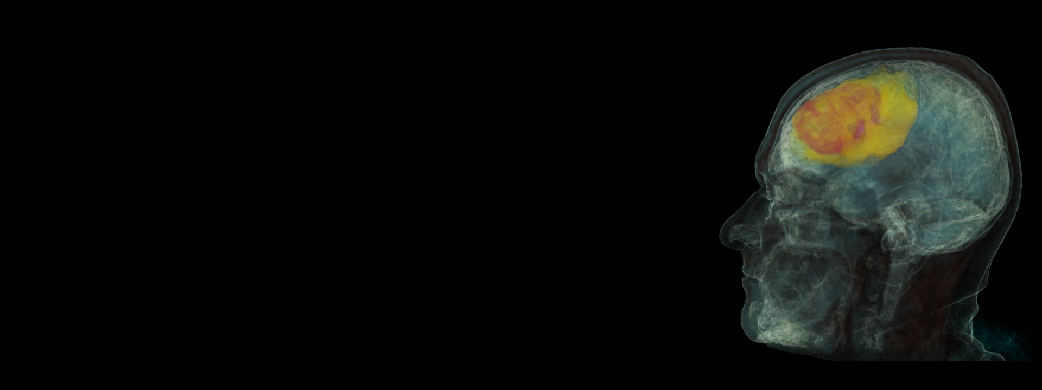
Deep Learning Approaches for Medical Image Analysis
Instructor: Fatima Kuehn
Course: DATA 530 – Artificial Intelligence
Deadline: 09/25/25
Team 7
Prabhjyot Chavan
Sri Vamsi Chitta
Siddartha Bandi

Slide 2

From Classification to Segmentation
01
Introduction
04
YOLO (Detection)
02
Paper Overview
05
U-Net (Segmentation)
03
ResNet (Classification)
06
Conclusion

Slide 3

Introduction
Medical imaging is critical in healthcare for diagnosis, treatment planning, and monitoring.
The rise of Artificial Intelligence (AI), particularly Deep Learning (DL), has revolutionized how medical images are analyzed.
Key tasks enabled by DL:
Classification – identifying diseases (e.g., tumor vs. healthy tissue).
Detection – localizing abnormalities (e.g., lung nodules, hemorrhage).
Segmentation – outlining organs or lesions (e.g., stroke lesion mapping).
Registration – aligning multimodal scans (e.g., CT + MRI fusion).
AI enhances accuracy, speed, and scalability while reducing clinician workload.

Slide 4

Paper Overview
Title: Advances in Deep Learning-Based Medical Image Analysis Authors: Liu, X. et al., Health Data Science, 2021
Provides a comprehensive review of deep learning applications in medical imaging.
Focuses on four main tasks: classification, detection, segmentation, and registration.
Discusses popular architectures: CNNs (AlexNet, VGG, ResNet), detection models (YOLO, Faster R-CNN), and segmentation networks (U-Net, nnU-Net).
Applications: Stroke and brain hemorrhage detection, cardiac structure analysis, liver lesion classification, and bone fracture recognition.
Key challenges:
Limited labeled datasets
Class imbalance
Model interpretability and trust
Future directions:
Transfer learning and federated learning for data efficiency and privacy
Explainable AI to improve transparency and clinical trust

Slide 5
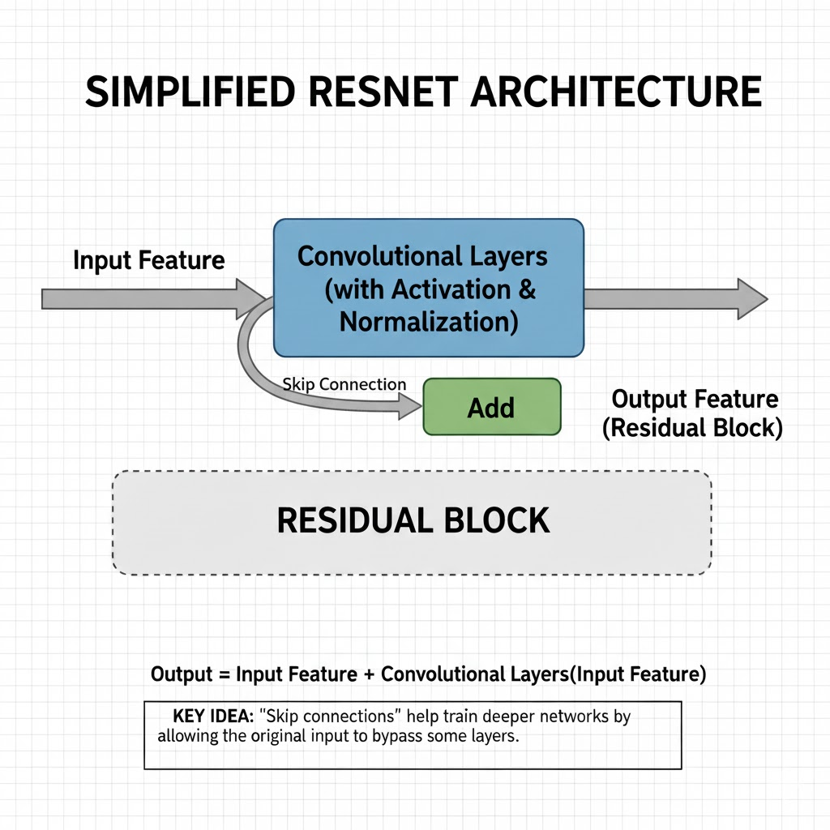
ResNet (Revolutionizing Deep Learning Classification)
What does ResNet do?
ResNet is an advanced deep learning model designed to classify images. For example, it can automatically distinguish between images of healthy tissue and tumors, helping doctors diagnose conditions faster and more accurately.
Key Feature: Skip Connections
Traditional neural networks pass information forward, layer by layer. ResNet introduces "skip connections"—these allow some inputs to bypass certain layers and flow directly to deeper sections of the network. This helps maintain important information, even in very deep models.
Why are Skip Connections Important?
In very deep networks, mathematical signals can become too weak to propagate, causing the “vanishing gradient” problem. Skip connections in ResNet prevent this, so learning is stable and effective even with many layers.
Think of a ResNet block like a highway system. Most of the data goes through the "main path" (like a local road with traffic lights) where it gets processed by convolutional layers. However, ResNet adds a "skip connection" (like an express highway) that allows the original, unchanged data to bypass this processing and meet up with the processed data at the end.
This structure makes it easier for the network to learn, as it can choose to use the original data directly if the processing in the main path isn't helpful.
Notes:
ResNet stands for "Residual Network." Its main innovation is the skip connection.
It overcomes limitations of older deep learning models, allowing deeper networks without loss of information.
In clinical settings, AI models like ResNet are revolutionizing diagnostics by improving accuracy and speed.
The diagram shows how skip connections jump across layers, ensuring strong information flow.
Key takeaway: Deep networks + skip connections = better performance, especially for critical applications like medical diagnostics.

Slide 6
The Core Idea
The Main Path
This is the standard part of a convolutional neural network. The input data goes through two Conv_Layer blocks, which are responsible for finding patterns. Batch_Norm helps stabilize the training, and ReLU is an activation function that helps the network learn non-linear relationships.
2. The Skip Connection
This is the special part of ResNet.
We first save a copy of the original input as identity.
The if statement is a critical check. Sometimes, a Conv_Layer will shrink the data's size (using a stride). If that happens, we can't add our identity (e.g., a 64x64 image) to our processed data x (e.g., a 32x32 image).
To fix this, we use a simple Conv_1x1 on the identity to resize it so the shapes match perfectly.
3. Combine and Activate
The Add function is where the magic happens. It merges the heavily processed data from the main path with the original (or resized) data from the skip connection.
Finally, a ReLU activation is applied to the combined output before it's passed on to the next block in the network.
Pseudocode for a ResNet Block
This code defines a single "Residual Block," which is the fundamental building block of a ResNet.
function ResidualBlock(input, output_channels, stride=1):
# 1. Save the original input for the skip connection.
identity = input
# --- MAIN PATH (The "Local Road") ---
# This path processes the data.
x = Conv_Layer(input, output_channels, stride)
x = Batch_Norm(x)
x = ReLU(x)
x = Conv_Layer(x, output_channels)
x = Batch_Norm(x)
# --- SKIP CONNECTION (The "Express Highway") ---
# If the main path changed the data's shape (e.g., made it smaller),
# we must adjust the skip connection to match.
if shape(x) != shape(identity):
identity = Conv_1x1(identity, output_channels, stride)
# --- COMBINE THE PATHS ---
# 3. Add the output of the main path and the skip connection.
output = Add(x, identity)
# 4. Apply the final activation function.
output = ReLU(output)
return output
Notes:
ResNet stands for "Residual Network." Its main innovation is the skip connection.
It overcomes limitations of older deep learning models, allowing deeper networks without loss of information.
In clinical settings, AI models like ResNet are revolutionizing diagnostics by improving accuracy and speed.
The diagram shows how skip connections jump across layers, ensuring strong information flow.
Key takeaway: Deep networks + skip connections = better performance, especially for critical applications like medical diagnostics.

Slide 7
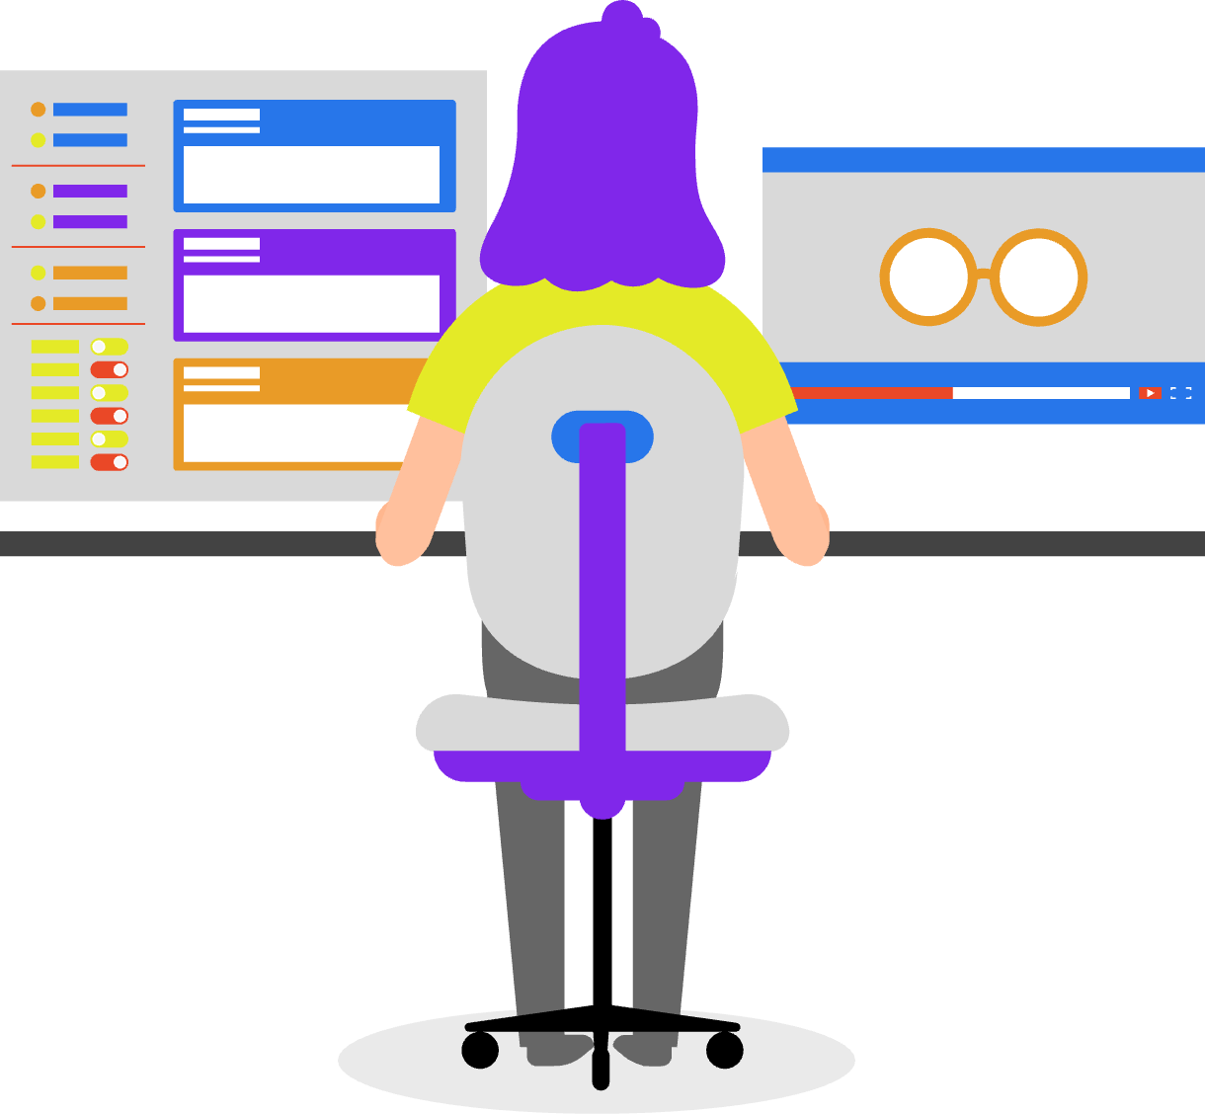
ResNet (Classification)
Advantage
The skip connections enable ResNet to train extremely deep networks, resulting in higher accuracy and reliability for image classification tasks.
Clinical Example
ResNet is used in medical imaging—such as detecting brain tumors on MRI scans or classifying skin lesions as cancerous or benign. By automating classification, ResNet supports doctors in making quicker, more accurate decisions.
Notes:
ResNet stands for "Residual Network." Its main innovation is the skip connection.
It overcomes limitations of older deep learning models, allowing deeper networks without loss of information.
In clinical settings, AI models like ResNet are revolutionizing diagnostics by improving accuracy and speed.
The diagram shows how skip connections jump across layers, ensuring strong information flow.
Key takeaway: Deep networks + skip connections = better performance, especially for critical applications like medical diagnostics.

Slide 8
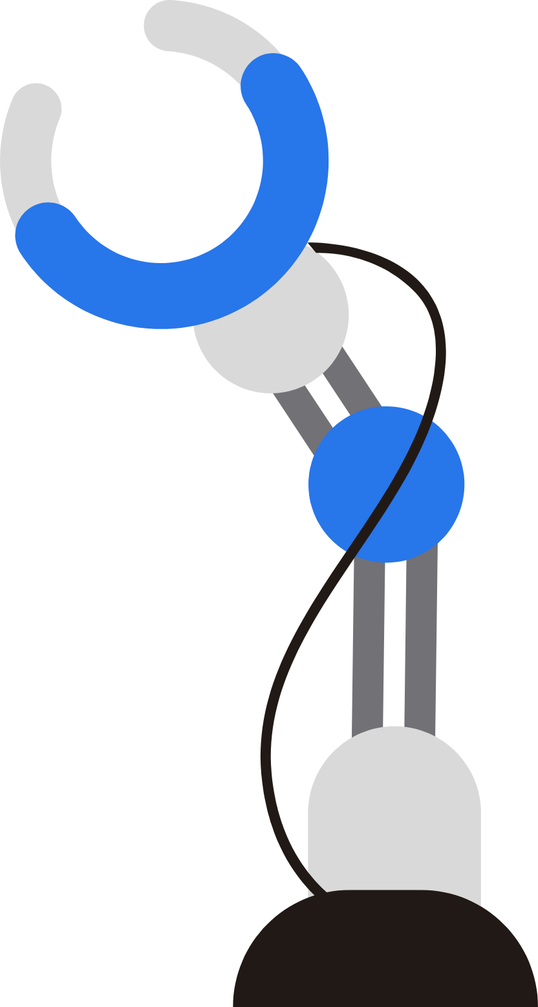
YOLO (Detection)
04
What it is: YOLO is a single-stage object detection algorithm. Instead of scanning an image region by region (like older methods), it looks at the whole image once and predicts bounding boxes + class probabilities directly.
Why it matters: This makes YOLO fast and efficient, suitable for real-time detection.
How it works (briefly):
The image is divided into a grid.
Each grid cell predicts bounding boxes and the probability of objects (e.g., tumor, fracture, lesion).
A post-processing step (Non-Maximum Suppression) removes duplicate boxes.
Medical Applications:
Detecting lung nodules in chest CT/X-ray.
Identifying lesions in CT/MRI.
Locating fractures in bone X-rays.
Notes:
ResNet stands for "Residual Network." Its main innovation is the skip connection.
It overcomes limitations of older deep learning models, allowing deeper networks without loss of information.
In clinical settings, AI models like ResNet are revolutionizing diagnostics by improving accuracy and speed.
The diagram shows how skip connections jump across layers, ensuring strong information flow.
Key takeaway: Deep networks + skip connections = better performance, especially for critical applications like medical diagnostics.

Slide 9
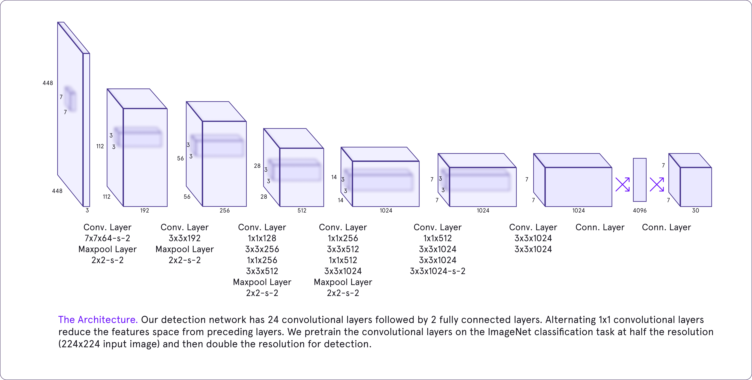
ARCHITECTURE
Notes:
ResNet stands for "Residual Network." Its main innovation is the skip connection.
It overcomes limitations of older deep learning models, allowing deeper networks without loss of information.
In clinical settings, AI models like ResNet are revolutionizing diagnostics by improving accuracy and speed.
The diagram shows how skip connections jump across layers, ensuring strong information flow.
Key takeaway: Deep networks + skip connections = better performance, especially for critical applications like medical diagnostics.

Slide 10
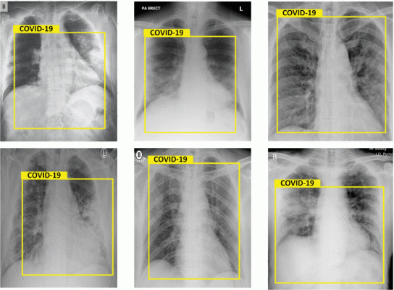
Example :
This image set shows six chest X-rays with yellow bounding boxes labeled "COVID-19," illustrating the application of automated detection algorithms, likely YOLO or a similar object detection model, in identifying suspected COVID-19 cases based on radiographic features.
Each X-ray displays a bounding box drawn over the lungs area, where the algorithm has detected patterns consistent with COVID-19 infection.
The yellow box and label indicate that the AI model has flagged these regions for review as potential evidence of COVID-19.
This approach allows rapid triage and supports radiologists by highlighting critical cases needing expert evaluation, enabling healthcare professionals to focus on suspected COVID-19 patients more efficiently.
Such object detection models quickly process large volumes of X-rays and help sort cases for further clinical testing, enhancing diagnostic speed and supporting pandemic response efforts.
7
Notes:
ResNet stands for "Residual Network." Its main innovation is the skip connection.
It overcomes limitations of older deep learning models, allowing deeper networks without loss of information.
In clinical settings, AI models like ResNet are revolutionizing diagnostics by improving accuracy and speed.
The diagram shows how skip connections jump across layers, ensuring strong information flow.
Key takeaway: Deep networks + skip connections = better performance, especially for critical applications like medical diagnostics.

Slide 11

Takeaways:
YOLO offers fast, real-time object detection ideal for urgent medical diagnoses.
It detects and localizes multiple abnormalities simultaneously.
Effective in many medical imaging applications like lesion, tumor, fracture, and COVID-19 detection.
Pros
Real-time processing suitable for time-sensitive clinical environments.
Computationally efficient with a unified detection and classification framework.
High accuracy with contextual understanding of images.
Adaptable to different medical imaging domains.
Lower false positive rates due to global context analysis.
Cons
Requires large, well-annotated datasets.
Struggles with detecting small or occluded objects.
Performance sensitivity to object scale.
Less effective with highly diverse object classes not covered in training data.
This balance of fast speed, accuracy, and adaptability makes YOLO models powerful but also dependent on good data and careful tuning for best clinical use.
7
Notes:
ResNet stands for "Residual Network." Its main innovation is the skip connection.
It overcomes limitations of older deep learning models, allowing deeper networks without loss of information.
In clinical settings, AI models like ResNet are revolutionizing diagnostics by improving accuracy and speed.
The diagram shows how skip connections jump across layers, ensuring strong information flow.
Key takeaway: Deep networks + skip connections = better performance, especially for critical applications like medical diagnostics.

Slide 12
U-Net (Segmentation)
What is U-Net ?
U-Net is a kind of neural network mainly used for image segmentation which means dividing an image into different parts to identify specific objects for example separating a tumor from healthy tissue in a medical scan. The name “U-Net” comes from the shape of its architecture which looks like the letter “U” when drawn. It is widely used in medical imaging because it performs well even with a small amount of labeled data.
8
Notes:
Now, let’s talk about U-Net, one of the most popular deep learning architectures for medical image segmentation. U-Net was first proposed in 2015 by Olaf Ronneberger and his team for biomedical image segmentation tasks. The key idea behind U-Net is that it performs pixel-wise classification, meaning that each pixel in the image is labeled as part of a structure, such as a tumor or organ, or as background. Unlike regular CNNs that only extract features and classify entire images, U-Net learns to locate and label objects precisely, even when the dataset is small. It’s called U-Net because of its symmetric ‘U’-shaped architecture — with a contracting path on the left and an expanding path on the right.

Slide 13
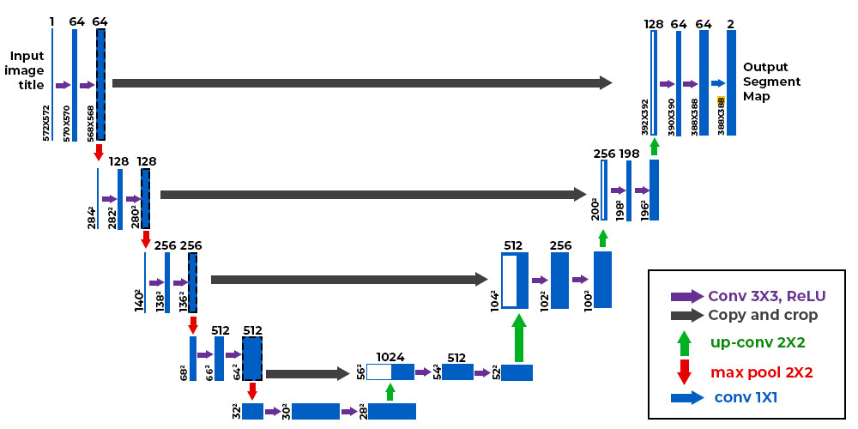
U-Net Architecture
The architecture is symmetric and has three key parts:
Contracting Path (Encoder):
Uses small filters (3×3 pixels) to scan the image and find features.
Apply an activation function called ReLU to add non-linearity help the model to learn better.
Uses max pooling (2×2 filters) to shrink the image size while keeping important information. This helps the network focus on bigger features.
Bottleneck:
The middle of the “U” where the most compressed and abstract information is stored. It links the encoder and decoder.
Expansive Path (Decoder):
Uses up sampling i.e increasing image size to get back the original image size.
Combines information from the encoder using “skip connections.” These connections help the decoder get spatial details that might have been lost when shrinking the image.
Uses convolution layers again to clean up and refine the output.
The image shows U-Net turning a 572×572 image into a smaller 388×388 segmented map. It shrinks the image to capture features then up samples to restore size using skip connections to keep details. The output labels each pixel as object or background.
https://www.geeksforgeeks.org/machine-learning/u-net-architecture-explained/
8
Notes:
The U-Net architecture has three main parts: an Encoder and a Decoder, connected by Skip Connections.
The Encoder, also called the contracting path, uses convolution and max-pooling layers to extract hierarchical features and reduce spatial size.
The Bottleneck layer sits at the bottom — it captures the most compressed yet informative representation of the image.
The Decoder, or the expanding path, up samples the features to recover the original image resolution and localize objects.
The Skip Connections connect corresponding encoder and decoder layers. They pass detailed spatial information forward, which helps retain edge and boundary details.
Finally, a 1×1 convolution layer maps the features into the final segmentation output — where each pixel is assigned to a specific class.”

Slide 14
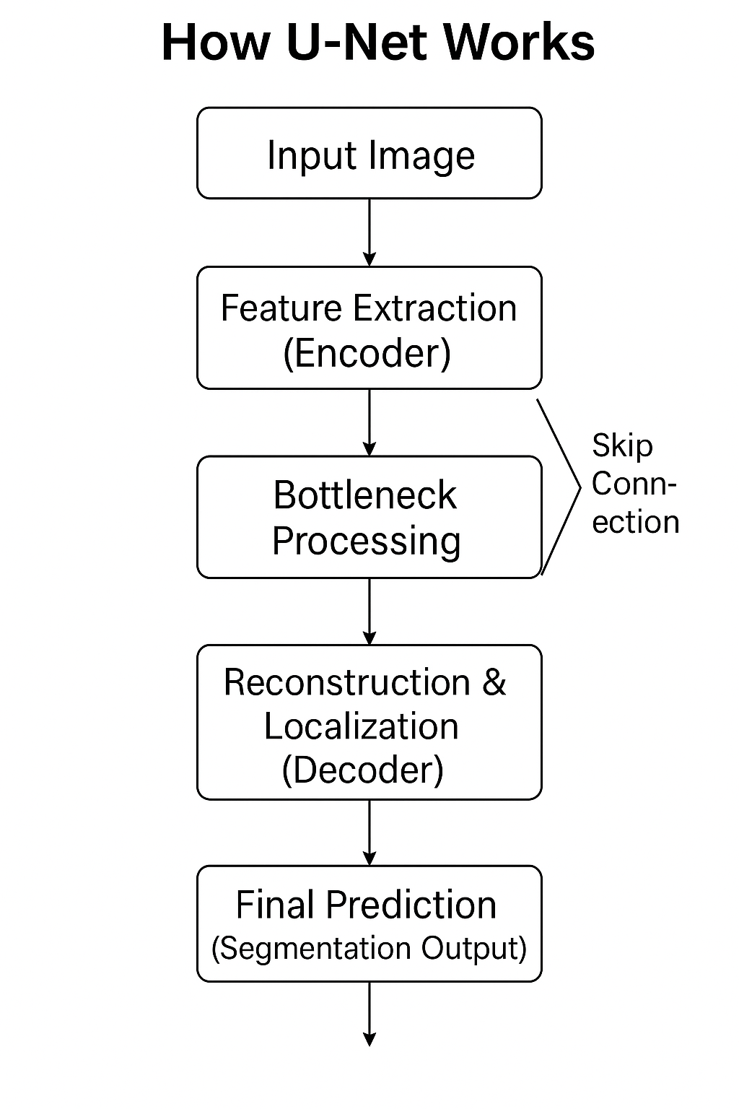
U-Net Flowchart
8
Notes:
This diagram clearly shows how the data flows — from input image, through feature extraction, to the final segmentation mask.

Slide 15
The Core Idea
The Encoder (Contracting Path)
This is like a regular CNN feature extractor.
Each Conv_Block does: Conv → Norm (optional) → ReLU → Conv → Norm → ReLU.
After each block (except the last), a MaxPool(2×2) halves H×W and doubles channels.
We save each block’s output as a skip feature for later use in the decoder.
Skip Connections (U-shaped bridges)
This is the special part of U-Net.
For every encoder level ℓ, we keep the feature map SℓSℓ​.
In the decoder, when we upsample back to that resolution, we concatenate the upsampled features with SℓSℓ​.
If shapes don’t match (due to “valid” padding or odd sizes), center-crop or pad the encoder feature so concatenation is valid.
The Decoder (Expansive Path) + Final Prediction
Each decoder level does: Up-sample ×2 (ConvTranspose or Upsample+Conv) → Concat with skip SℓSℓ​ → Conv_Block for refinement.
At the end, a 1×1 Conv maps channels to the number of classes.
Apply Sigmoid (binary) or Softmax (multi-class) to get the segmentation map.
8
Notes:
This diagram clearly shows how the data flows — from input image, through feature extraction, to the final segmentation mask.

Slide 16
Pseudo code
# Up block: either ConvTranspose2d(k=2,s=2) or Upsample×2 + Conv3x3
function Up_Block(x, out_channels):
x = ConvTranspose2x2(x, out_channels) # or Upsample(scale=2) → Conv3x3
return x
# ---------- U-Net forward ----------
# L = number of encoder/decoder levels (e.g., 4); F0 = base channels (e.g., 64)
function UNet_Forward(input, L=4, F0=64, K=1):
skips = []
x = input
channels = F0
# ----- Encoder -----
for ℓ in 1..L:
x = Conv_Block(x, channels) # features at this scale
skips.append(x) # save for skip connection
if ℓ < L: # no pool after last encoder block
x = MaxPool2x2(x)
channels = channels * 2 # double channels each down step
# ----- Bottleneck -----
x = Conv_Block(x, channels * 2) # deeper, richer features
# ----- Decoder -----
for ℓ in L..1: # go back up
x = Up_Block(x, channels) # upsample by 2
s = skips[ℓ] # encoder feature at this scale
# If shapes mismatch (valid padding / odd dims): crop or pad 's'
if shape(s).H != shape(x).H or shape(s).W != shape(x).W:
s = CenterCropOrPad(s, targetHW=(shape(x).H, shape(x).W))
x = ConcatChannels(x, s) # skip connection (concat)
x = Conv_Block(x, channels) # refine fused features
channels = channels // 2 # halve channels as we go up
# ----- Head -----
logits = Conv1x1(x, out_channels=K)
if K == 1:
probs = Sigmoid(logits) # binary segmentation
else:
probs = Softmax(logits, dim="channels") # multi-class
return probs # per-pixel probabilities (H×W×K)
8
Notes:
This diagram clearly shows how the data flows — from input image, through feature extraction, to the final segmentation mask.

Slide 17
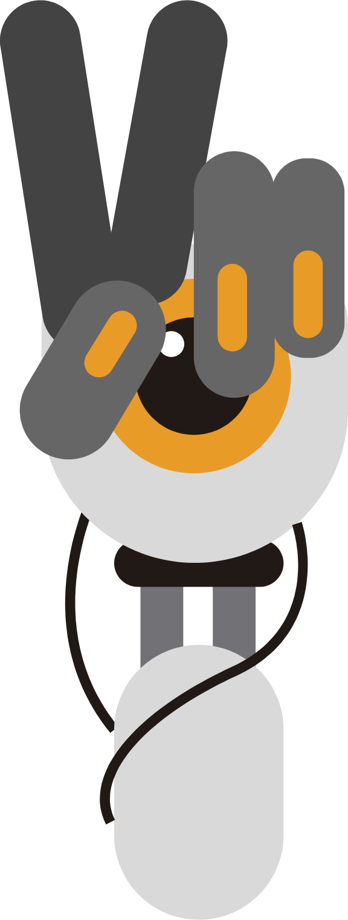
Distinctive Key Highlights
ResNet – Revolutionizing Deep Learning Classification
Innovation: Skip connections act as express lanes, letting information travel across layers without getting lost—empowering ultra-deep networks.
YOLO (You Only Look Once) – Real-Time Object Detection
Standout Feature: Processes the entire image in a single pass to locate and label regions of interest, providing live feedback for clinical screening and emergency diagnostics.
U-Net – Precision Image Segmentation
Signature: The “U”-shaped architecture combines context and detail, capturing both the big picture and fine structure—creating accurate masks even from small datasets.
Breakthrough Impact: These models together accelerate medical workflow:
ResNet classifies complex patterns.
YOLO detects abnormalities instantly.
U-Net outlines every clinical detail with pixel-level accuracy.
They make AI not only faster and smarter, but deeply trustworthy—reshaping the future of healthcare.
9
Notes:
Resnet: It skips some connections and process some connections to give better network.
YOLO: It process the entire image into one go to locate the region of interest which provides feedbacks for clinincal screenings or emergency diagnostics.
U-net: Its basically a U shaped architecture which gives a precise detailed structures of the image and it also works for small datasets.

Slide 18
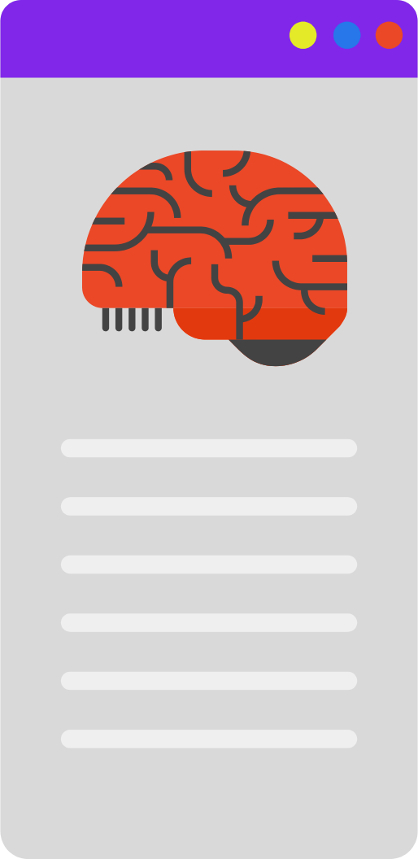
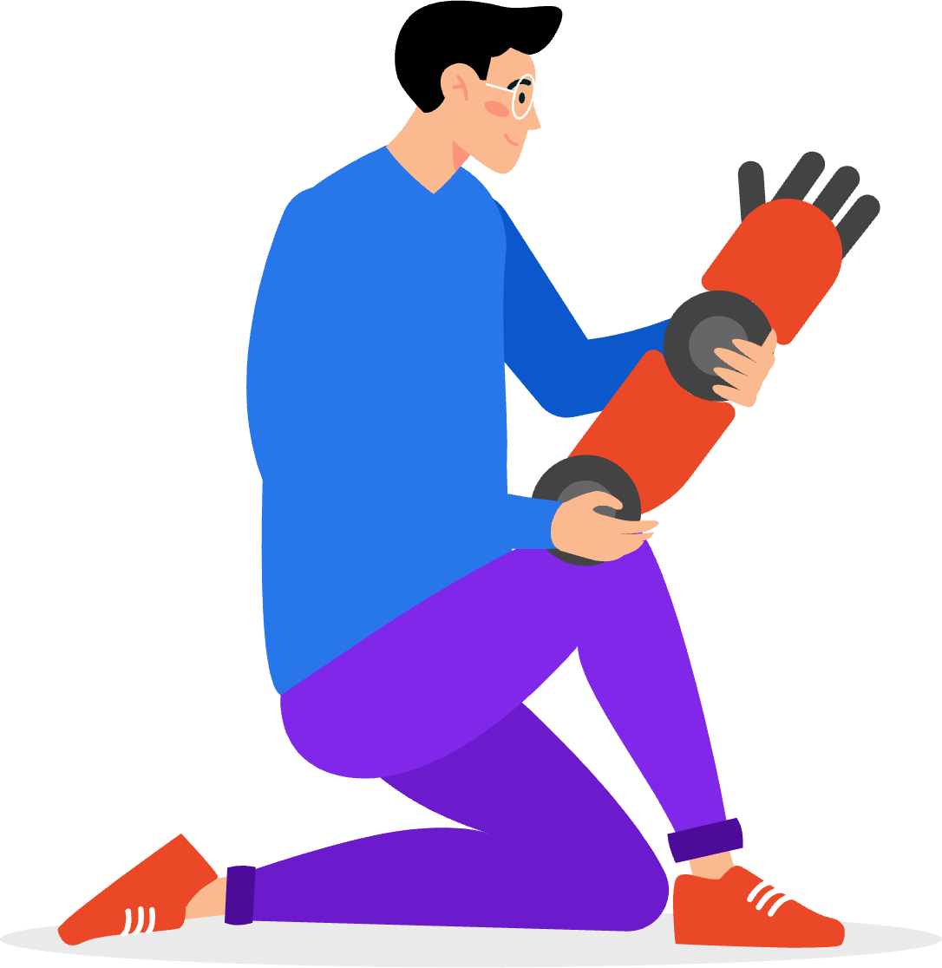
Conclusion
This project explored state-of-the-art AI models—ResNet, YOLO, and U-Net—applied to medical imaging, focusing on their unique strengths in classification, detection, and segmentation tasks.
ResNet: Accurate image classification using deep networks and skip connections.
YOLO: Fast, real-time detection of multiple abnormalities in clinical scans.
U-Net: High-precision segmentation to outline organs or lesions.
Drawing from our selected research paper and guided by project proposal requirements, we found that these advanced deep learning models have achieved remarkable accuracy and reliability across diverse clinical applications, including detection of brain tumors, skin cancer, cardiac diseases, and more. However, challenges remain—especially concerning limited annotated datasets and class imbalance—which point to the need for future research in transfer learning, federated learning, and integration of domain knowledge.
This work aligns with the proposal guidelines, thoroughly explaining and teaching each model’s architecture and clinical application, and highlighting their relevance through clear examples and project findings.
10
Notes:
ResNet stands for "Residual Network." Its main innovation is the skip connection.
It overcomes limitations of older deep learning models, allowing deeper networks without loss of information.
In clinical settings, AI models like ResNet are revolutionizing diagnostics by improving accuracy and speed.
The diagram shows how skip connections jump across layers, ensuring strong information flow.
Key takeaway: Deep networks + skip connections = better performance, especially for critical applications like medical diagnostics.

Slide 19
References
1.Liu, X., Gao, K., Liu, B., Pan, C., Liang, K., Yan, L., … Yu, Y. (2021). Advances in Deep Learning-Based Medical Image Analysis. Health Data Science, 2021, Article ID 8786793. https://doi.org/10.34133/2021/8786793
He, K., Zhang, X., Ren, S., & Sun, J. (2016). Deep Residual Learning for Image Recognition. Proceedings of the IEEE Conference on Computer Vision and Pattern Recognition (CVPR), 770–778. https://doi.org/10.1109/CVPR.2016.90
Ronneberger, O., Fischer, P., & Brox, T. (2015). U-Net: Convolutional Networks for Biomedical Image Segmentation. International Conference on Medical Image Computing and Computer-Assisted Intervention (MICCAI), 234–241. https://arxiv.org/abs/1505.04597
Redmon, J., Divvala, S., Girshick, R., & Farhadi, A. (2016). You Only Look Once: Unified, Real-Time Object Detection. Proceedings of the IEEE Conference on Computer Vision and Pattern Recognition (CVPR), 779–788. https://arxiv.org/abs/1506.02640
Litjens, G., Kooi, T., Bejnordi, B. E., et al. (2017). A Survey on Deep Learning in Medical Image Analysis.Medical Image Analysis, 42, 60–88. https://doi.org/10.1016/j.media.2017.07.005
Esteva, A., Kuprel, B., Novoa, R. A., et al. (2017). Dermatologist-level Classification of Skin Cancer with Deep Neural Networks. Nature, 542, 115–118. https://doi.org/10.1038/nature21056
Shen, D., Wu, G., & Suk, H. I. (2017). Deep Learning in Medical Image Analysis. Annual Review of Biomedical Engineering, 19, 221–248. https://doi.org/10.1146/annurev-bioeng-071516-044442
10
Notes:
ResNet stands for "Residual Network." Its main innovation is the skip connection.
It overcomes limitations of older deep learning models, allowing deeper networks without loss of information.
In clinical settings, AI models like ResNet are revolutionizing diagnostics by improving accuracy and speed.
The diagram shows how skip connections jump across layers, ensuring strong information flow.
Key takeaway: Deep networks + skip connections = better performance, especially for critical applications like medical diagnostics.

Slide 20
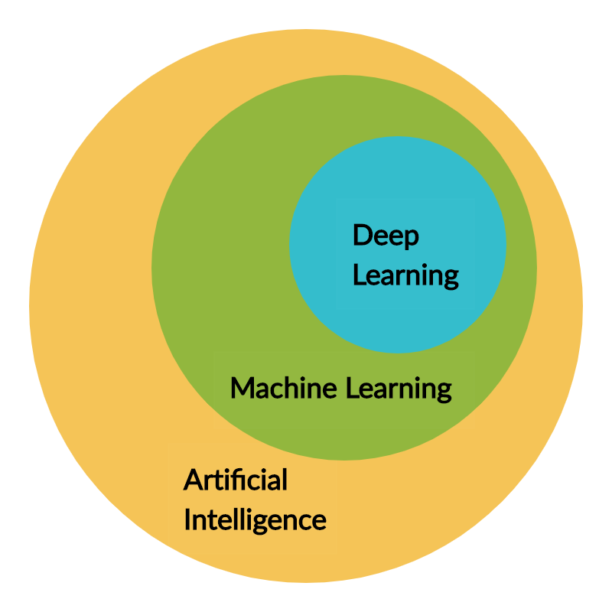
Discussion
and
Questions
11
Notes:
ResNet stands for "Residual Network." Its main innovation is the skip connection.
It overcomes limitations of older deep learning models, allowing deeper networks without loss of information.
In clinical settings, AI models like ResNet are revolutionizing diagnostics by improving accuracy and speed.
The diagram shows how skip connections jump across layers, ensuring strong information flow.
Key takeaway: Deep networks + skip connections = better performance, especially for critical applications like medical diagnostics.

